Slide 1

Chapter 7
Design: Architecture and Methodology

Slide 2

Design Topics Covered
Architectural .vs. Detailed design
“Common” architectural styles, tactics and reference architectures
Basic techniques for detailed design
Basic issues with user-interface design

Slide 3
Design
Starts mostly from/with requirements (evolving mostly from functionalities and other non-functional characteristics)
How is the software solution going to be structured?
  What are the main components --- (functional comp)
    Often directly from Requirements’ Functionalities (use Cases)
  How are these components related ?
    possibly re-organize the components (composition/decomposition)
Two main levels of design:
  Architectural (high-level)
  Detailed design
How should we depict design--notation/language?

Slide 4
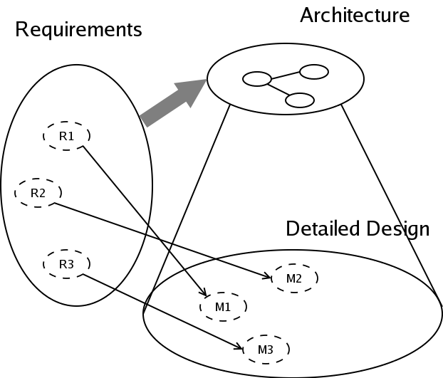
Relationship between Architecture and Design
Detailed Design
come from
Requirements &
Architecture

Slide 5
Software Architecture
Structure(s) of the solution, comprising:
  Major Software Elements
  Their externally visible properties
  Relationships among elements
Every software system has an architecture
May have Multiple structures !
  multiple ways of organizing elements, depending on the perspective
External properties of components (& modules)
  Component (Module) interfaces
  Component (Module) interactions, rather than internals of components and modules

Slide 6
Views and Viewpoints
View – Representation of a system structure
4+1 views (by Krutchen)
  Logical (OO decomposition – key abstractions)
  Process (run-time, concurrency/distribution of functions)
  Subsystem decomposition
  Physical architecture
  +1: use cases
Other classification (Bass, Clements, Kazman)
  Module
  Run-Time
  Allocation (mapping to development environment)
Different views for different people

Slide 7
Architectural Styles/Patterns
We discuss Architectural Styles/Patterns as
“reusable” starting point for Design activities
Pipes-and-Filters
Event-Driven
Client-Server
Model-View-Controller (MVC)
Layered
Database Centric
Three tier

Slide 8
Pipe-Filter architecture style
The high level design solution is decomposed into 2 “generic” parts (filters and pipes):
  Filter is a service that transforms a stream of input data into a stream of output data
  Pipe is a mechanism or conduit through which the data flows from one filter to another
Input
time cards
Prepare for
Check processing
Process Checks
** Reminds one of DFD without the data store or source sink **
Problems that require batch file processing seem to fit this architecture: e. g. payroll, compilers, month-end accounting

Slide 9
Event-Driven (Realtime)
The high level design solution is based on an event dispatcher which manages events and the functionalities which depends on those events. These have the following characteristics:
  Events may be a simple notification or may include associated data
  Events may be prioritized or be based on constraints such as time
  Events may require synchronous or asynchronous processing
  Events may be “registered” or “unregistered” by components
voice
call
Phone
processing
text
msg
Personal (device)
dispatcher
Txt
processing
Image
keypad
Image
processing
Problems that fit this architecture includes real-time systems such as: airplane control;
medical equipment monitor; home monitor; embedded device controller; game; etc.
- - - try a commercial flight control system - - -

Slide 10
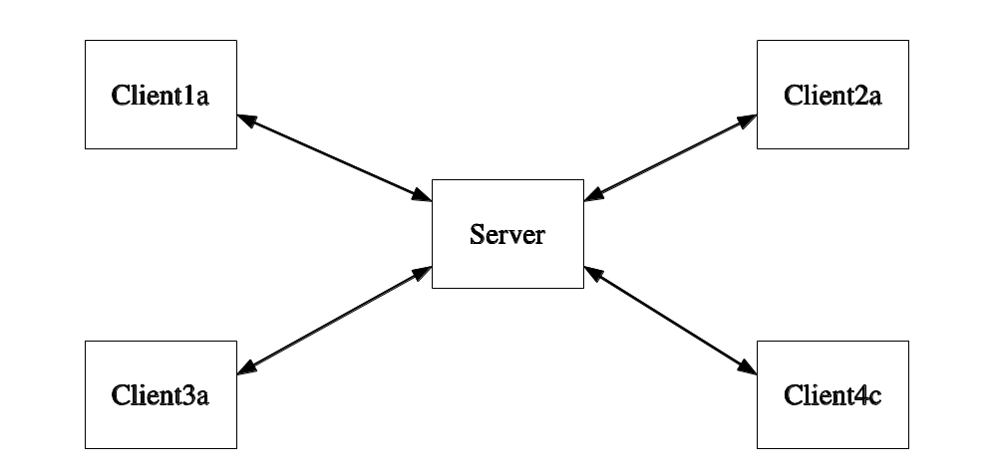
Basic Client-Server Style
Application split into client component and server component

Slide 11
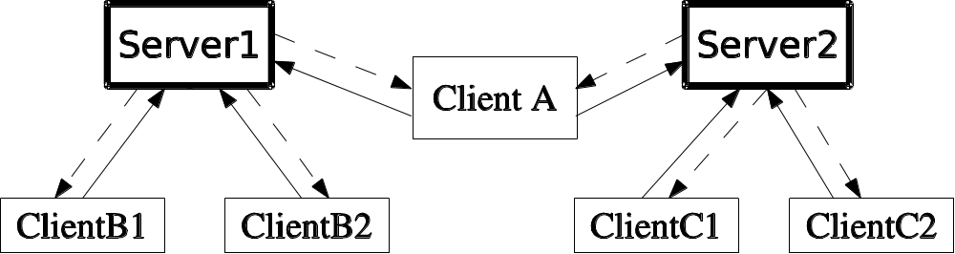
Client-Server Style
Client may connect to more than one server (servers are usually independent)

Slide 12
Model View Control (MVC) Style
Separates model (data) from view
Controller often integrated with view nowadays
View 1
Controller 1
Model
View 2
Controller 2
most of the internet web applications fall under this style

Slide 13
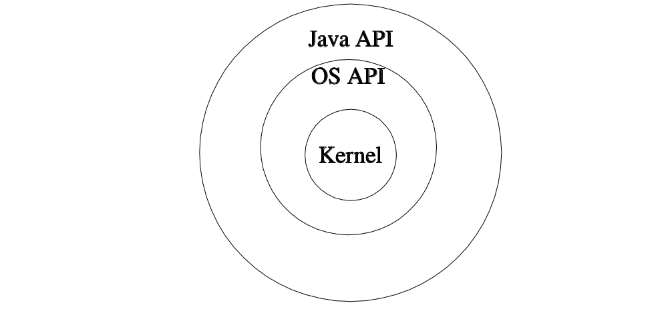
Layered Style
The “outer” layer can only ask for service from the “inner” layer
or “upper” layer can only ask for service from “lower” layer.
- strict layering----- only directly inside or below layers
- relaxed layering---- any inside or below layers

Slide 14
Shared Data (DB) centric style
Patient processing
Very popular within the business applications community
Room Scheduling
Hospital
DB
Purchasing
.
.
Nurses Scheduling

Slide 15
Three tier style (mixture)
Clients do not access DB directly
Better Flexibility, integrity (why?)
Client 1a
Client 1b
Business
Tier
DB
Client 2
Reminds one of Client-Server or MVC ?

Slide 16
Architectural Tactics
Tactics (in contrast to architectural style) are for solving “smaller, specific” problems
Do not affect overall structure of system
Example: we add specific functionalities or component (e.g. to increase reliability) in the design for fault detection ---- especially for distributed systems:
  heartbeat
  ping / echo

Slide 17
Reference Architectures
Full-fledged architectures
Serves as “templates” or as “a reference” for a class of systems
Example: J2EE Reference Architecture (MVC2)
Client1a
Business
Tier (EJB)
Web
Tier
Client1b
DB
Client2
There also are “application domain specific”
reference architectures

Slide 18
Detailed Design
Further Refine Architecture and match with Requirements
How detailed ?
How formal ?
Maybe of different levels of detail for different views

Slide 19
Functional Decomposition Technique
Dates back to “structured programming” [now (non-OO)Web apps with PHP tool]
Start with: main (task/requirements) -> module
Refine into sub-modules
There are alternative decompositions

Slide 20
Possible Decomposition of
(student- course management app)
0. Main
1.Student
2.Courses
3. Sections
4. Registration
1.1 Add
2.1 Add
3.1 Add
4.1 Register
1.2 Modify
2.2 Modify
3.2 Modify
4.2 Drop
1.3 Delete
2.3 Delete
3.3 Delete

Slide 21
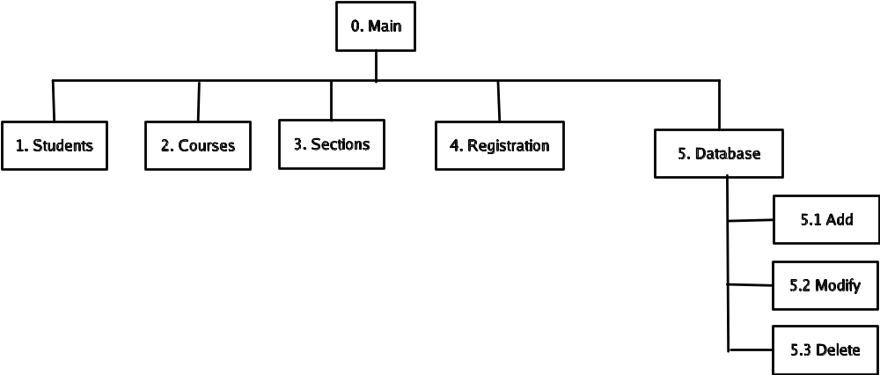
“Alternative” Decomposition/Composition

Slide 22
Relational Database Design
Most databases use relational technology
Relations (tables)
  Two-dimensional sets
  Rows (tuples), Columns (attributes)
    A Row may be an entity, Columns may be relationship or attributes
  Primary key (unique identifier) – for search
  Foreign keys (connects tables)

Slide 23
Database Design
Conceptual modeling (done during analysis/requirement phase) produces ER diagram
Logical design (to relational)
Physical design (decide data types, etc.)
Deployment/maintenance
  Low-level physical (which hard-drive etc)
  Adjustment of indexes

Slide 24
Entity-Relationship diagrams
Entities (rectangles)
  Weak – double lines
Relationships (diamonds)
Attributes (ovals)
  Multi-valued - double lines
  Identifying - underlined

Slide 25
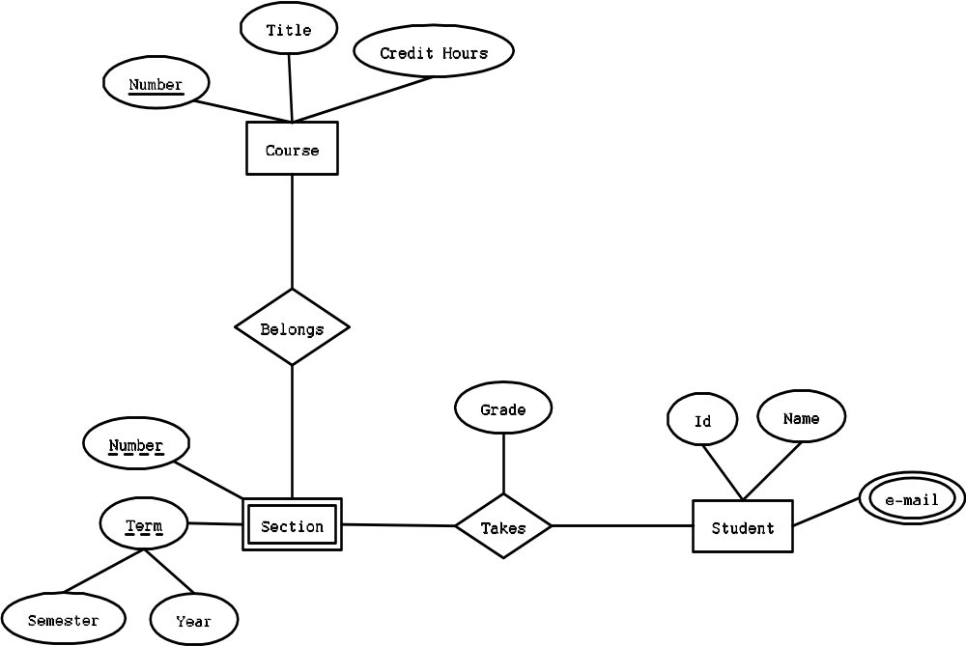
ER diagram

Slide 26
Logical DB Design- Entities
Table per entity
Flatten composite attributes
For weak entities, add the primary key of the strong entity
Course
Section
Course Number
CourseNumber
Title
SectionNumber
CreditHours
Semester
Year
Time
Location

Slide 27
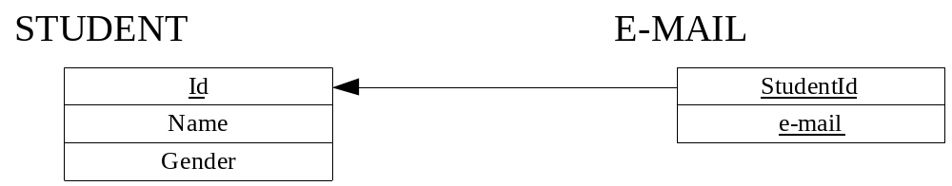
Logical DB Design – Multi-valued
New table needed for multi-valued attributes

Slide 28
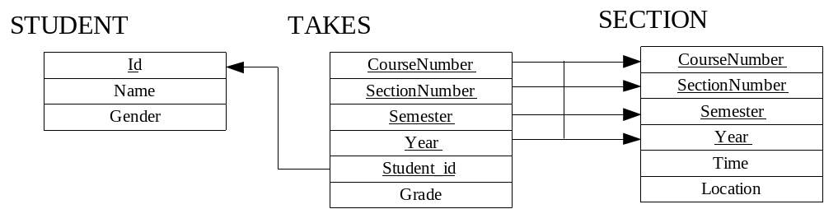
Logical DB Design - Relationships
If one side related to just one entity, add foreign key to that side
For many-to-many, need new table
For ternary, need new table

Slide 29
Physical DB Design
Data types for each attribute
  Check which ones your DBMS support
  Encoding
Decide on Indexes
  Searches are faster, updates are slower
  Indexes consume space
  Can always adjust during deployment
Denormalization done sometimes (avoid)

Slide 30
OO Design
First step: Review & Refine use cases
Decide
  Which classes to create
  How are the classes related
Use UML as the Design Language

Slide 31
Use case diagram
Add Course
Register For Section
Add Section
Student
Add Student
Choose Section
Registrar

Slide 32
Class Design
Classes represent real-world entities or system concepts
Organized into classes: objects in a class have similar characteristics
Classes have properties (attributes or data)
Classes also have methods (performs functions)
Student
dateOfBirth : Date
name : String
getAgeInYears() : int
getAgeInDays() : int

Slide 33
UML Class diagrams
Association
Composition
Is Enrolled
Student
0..*
1..1
School
Building
School
Bldg-Name: String
Bldg_number: int
Street-name: string
city : String
state : String
zipCode : int
Use “no-fill” diamond for aggregation

Slide 34
UML Class diagrams - Inheritance
Person
Student
Employee

Slide 35
UML State diagram
depicting a student’s “status” in school
Accepted
enroll:
Active
Alumni
graduate:
expel:
enroll:
fails to
enroll:
Expelled
Inactive

Slide 36
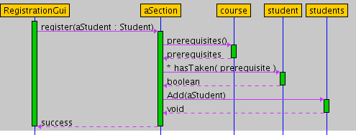
UML “Sequence Diagram”
used to depict a flow of interactions

Slide 37
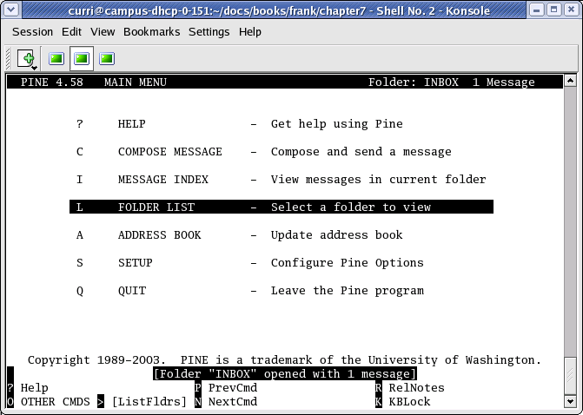
User Interface Design
Most apparent to the user
Two main issues
  i) Flow of interactions
  Ii) Look and feel
Types of interfaces
  Command-Line
  Text menus
  Graphical (GUI)

Slide 38
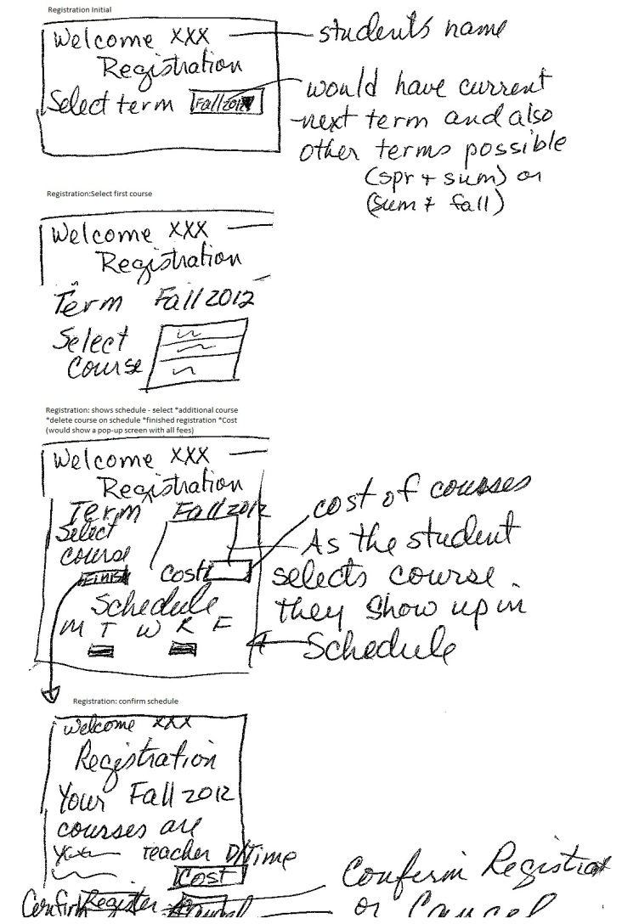
Flow of interactions
Prototype Screens
Registration:
  Select term
Registration: shows term
  Select first course
Registration: shows term, course(s) with schedule and cost
  Select *Additional course; *Delete course; *Finish registration
Registration: shows final schedule
  Select Confirm or Cancel

Slide 39
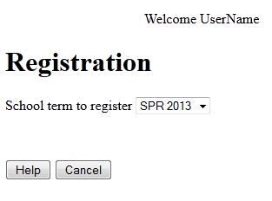
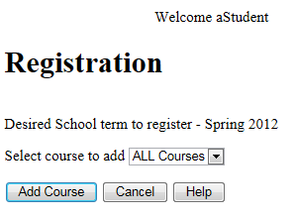
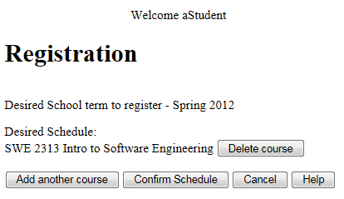
High Fidelity Prototype

Slide 40
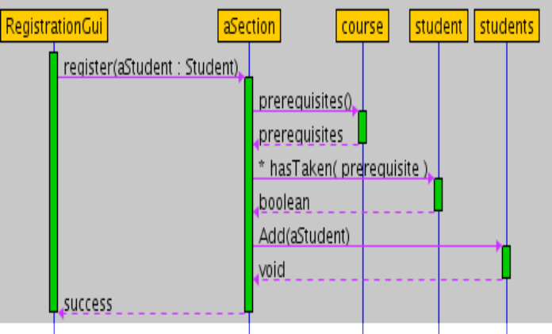
User: Screens: Process:
Student selects course and clicks “Add Course”
aStudent

Slide 41
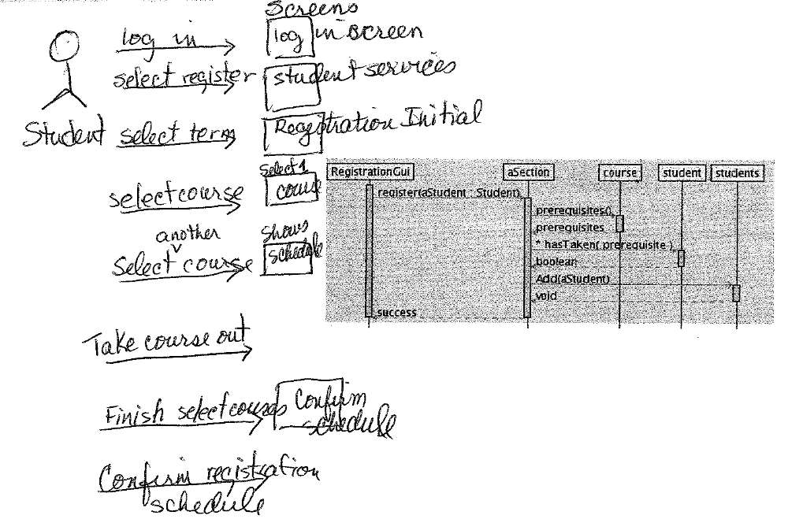
User interaction added to the sequence diagram

Slide 42
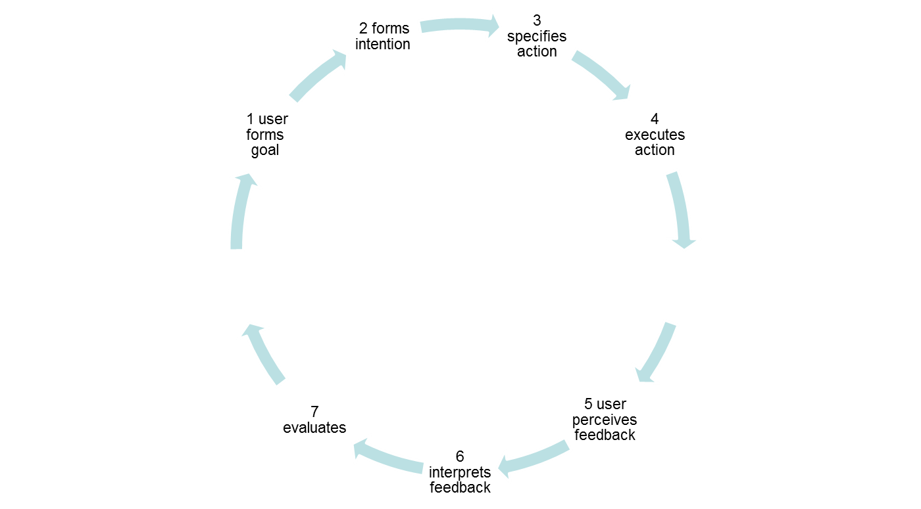
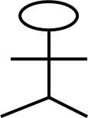
Norman’s 7 Stage Model

Slide 43
The GOMS Model
(an “advanced” topic for UI)
Consider different kinds of users
Four factors (for the kind of user)
  Goals of the user
  Operations provided by the system
  Methods or the sequence of operations
  Selection Rules for the methods

Slide 44
Other UI Issues
Kinds of users
Heuristics
UI Guidelines
Multicultural issues
Metaphors
Multiplatform software
Accessibility
Multimedia Interfaces

Slide 45
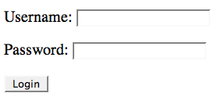
HTML-Script simple example
Sample HTML | Visual result (possible)
<form method="GET" action="something.php"> <p> Username: <input type="text" name="username"> </p> <p> Password: <input type="password" name="password"> </p> <input type="submit" value="Login"> </form>

Slide 46
Model-View-Controller (MVC) software project
View HTML
Controller PHP
Model
SQL database

Slide 47
Object-Relational Impedance Mismatch
(an “advanced” topic)
Relational Table
Elem 1
?
Elem 2
Encapsulated Object
Elem 3
Elem 4
Elem 5
How do we handle mismatches between object-oriented concepts and
Relational DB such as :
- typing
- private and public
- inheritance and polymorphism
- nested structure versus table structure

